Slide 1

Advertising Performance Intelligence Dashboard
Index:-
1. Business Problem & Objective 2. Data Overview & Data Modeling Approach3. Key KPIs Framework 4. Executive Overview Dashboard 5. Portfolio Performance Analysis 6. Campaign Performance Insights 7. Keyword Performance Analysis 8. Wasted Spend & Budget Leakage 9. Business Insights 10. Conclusion & Next Steps
Created By – Ashutosh Rawat Data Analyst- Digi Aansh Ecommerce Services

Slide 2

Problem Statement
Business Context & Objective
Advertising spend was increasing; however, performance efficiency and scalability lacked clear visibility.
Stakeholders had limited insight into traffic quality, conversion effectiveness, and areas of budget inefficiency.
Objective
Enable data-driven decision-making to clearly identify opportunities to Scale high-performing initiatives, Optimize underperforming areas, and Reduce or eliminate inefficient spend.

Slide 3

Data Overview
Data Source: Advertising performance data
Granularity: Portfolio, Campaign, Ad type, Targeting,Match type.
Key Metrics:
Impressions, Clicks, Spend, Orders, Sales, CTR, CPC, CVR, ACOS, ROAS

Slide 4
Data Modeling Approach
Data Model & Architecture
Implemented a Star Schema to ensure high performance, scalability, and analytical accuracy.
Fact Table
Centralized campaign-level performance metrics
Keyword-level performance metrics for granular analysis
Dimension Tables
Campaign
Keyword
Date

Slide 5
KPI Framework
Traffic KPIs:
Impressions, CTR, CPC, Clicks
These assess reach, engagement, and cost efficiency of ads Sales KPIs:
Orders, Sales, CVR, ACOS, ROAS
These measure conversion quality, profitability, and return on ad spend
Helps identify high-quality vs low-quality traffic
Highlights conversion and efficiency gaps in campaigns
Enables data-driven decisions to scale winning campaigns, optimize underperformers, or cut inefficient spend

Slide 6
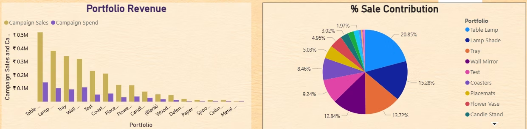
Executive Overview
Revenue is heavily concentrated in a few top portfolios (Table Lamp, Lamp Shade, Tray).
These portfolios drive the majority of sales with controlled spend, making them key growth drivers.
A small set of portfolios contributes App 50 % of total sales. (Table Lamp, Lamp Shade, Tray)
Remaining portfolios have fragmented, low contribution, increasing management complexity.
Clear visibility into where spend converts vs leaks.Insight:👉 Business is portfolio-dependent, not evenly distributed — this is critical for budget prioritization.

Slide 7
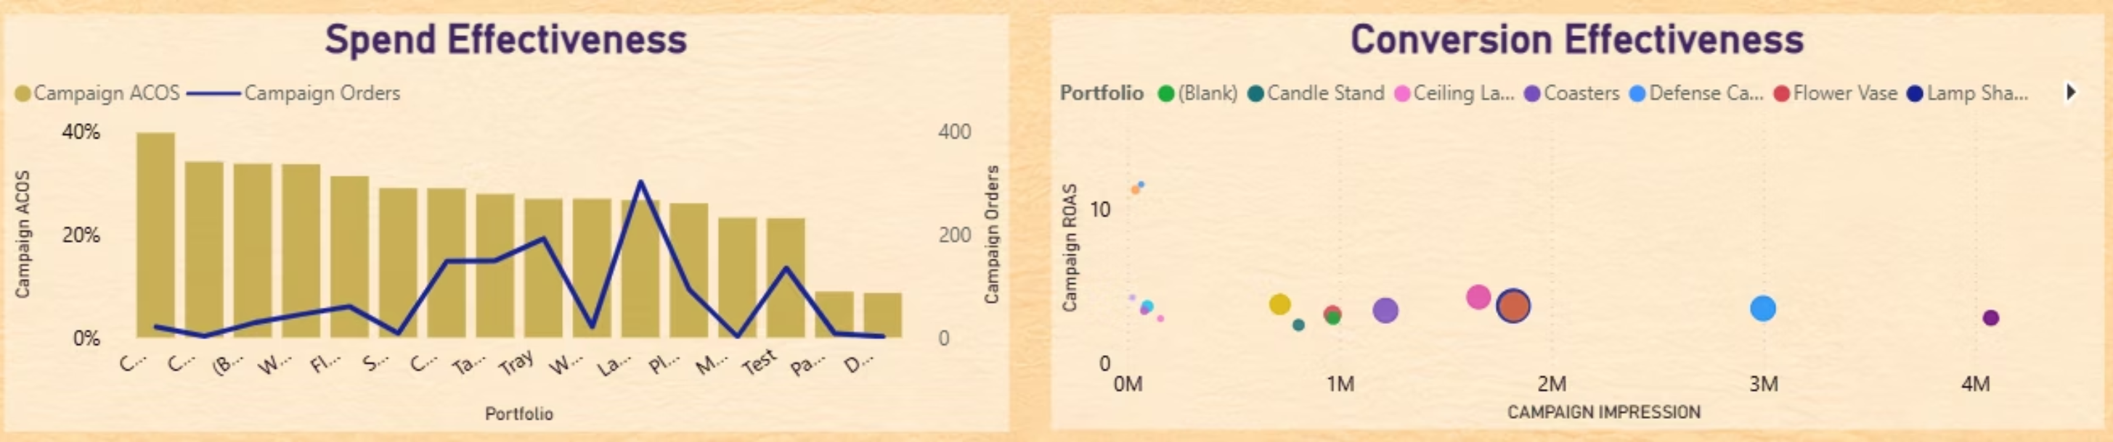
Portfolio Analysis
Spend Effectiveness (ACOS vs Orders – Combo Chart)
Some portfolios show high orders with controlled ACOS → efficient spend.
Others display high ACOS with weak order volume → inefficient budget usage.
Clear visibility into where spend converts vs leaks.
Insight: Identifies optimize vs cut decisions instantly.Conversion & Traffic Quality (Impressions vs ROAS – Bubble Chart)
High-impression portfolios with low ROAS indicate poor traffic quality or weak conversion.
Portfolios with moderate impressions but high ROAS are the most scalable.
Bubble size highlights conversion power, not just traffic volume.
Insight:More traffic ≠ better performance. Quality traffic wins.

Slide 8
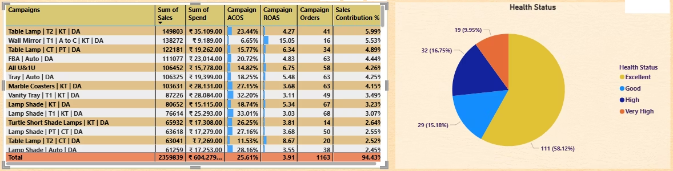
Campaign Health
A few campaigns show very high ACOS (80–150%+), clearly driving inefficiency and cost leakage.
Click volume is concentrated in better-performing campaigns, not in high-ACOS outliers.
High CPC + High ACOS campaigns are the weakest performers and require immediate action.
Low ACOS, high-click campaigns are ideal for scaling budgets.

Slide 9
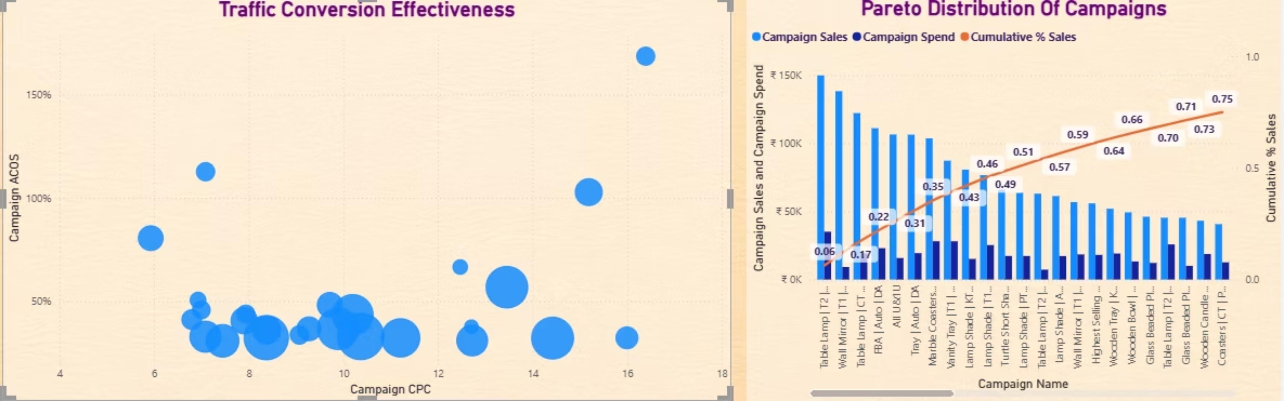
Sales & Traffic Insights
The Bubble Graph shows the cost effectiveness of the campaigns the bubble at lower left as per ascending size describes the traffic converted with less ACOS.The PARETO Graph shows:-A small number of campaigns on the left generate a large share of total sales.
Sales drop sharply as you move right 👉 Insight:Not all campaigns matter equally. A few drive most of the revenue.

Slide 10
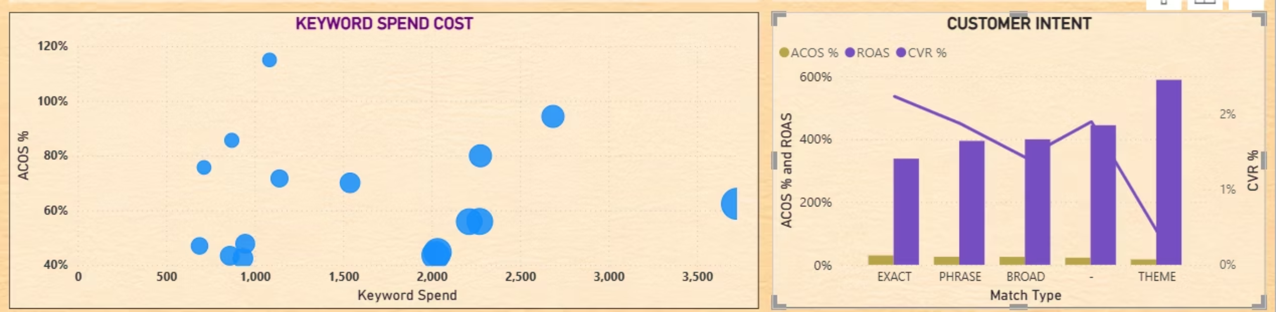
Customer intent With Spend Sense
KEYWORD SPEND vs ACOS (Left Scatter)High Spend ≠ High Efficiency
Several high-spend keywords (₹2K–₹3.5K) are operating at 50–95% ACOS.
These keywords are costly and inefficient → margin risk.CUSTOMER INTENT – Match Type Analysis (Right Chart)Traffic quality improves as match type becomes more specific, while scale increases as intent broadens — but at the cost of efficiency."Keyword efficiency is intent-driven: Exact match delivers profitability, while Broad and Theme drive scale with higher efficiency risk."

Slide 11
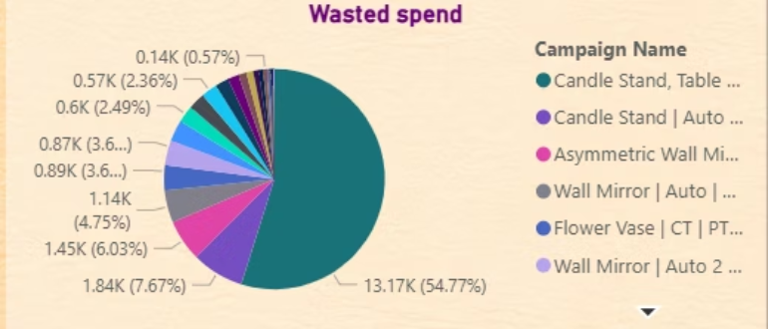
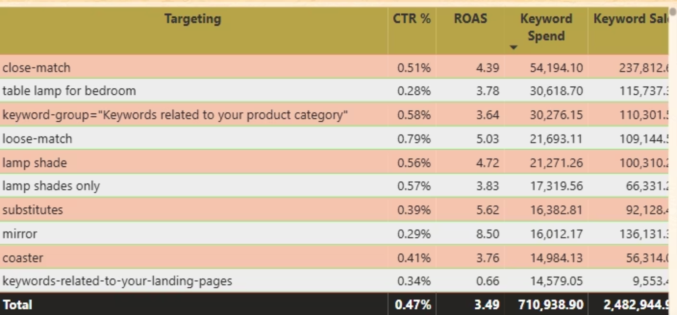
Campaign &Keyword Insights
Spend concentration is highly skewed: One campaign alone accounts for ~55% (₹13.17K) of total wasted spend, making it the primary inefficiency driver.
We can check the effectiveness if the targeting on the basis of different match type and Ad type or targeting type by using the campaign data as it is connected to the campaigns.

Slide 12
Conclusion
What the data confirms:
Scale exists — several campaigns and keywords deliver strong ROAS, low ACOS, and healthy CVR, proving the model works.
Efficiency improves when intent is high — loose-match, substitute, and product-specific keywords consistently outperform broad or generic targeting.
Spend is unevenly productive — top portfolios and campaigns contribute a disproportionate share of sales (Pareto effect), while long-tail segments add cost with limited return.
Traffic quality matters more than volume — higher impressions do not guarantee results; conversion efficiency separates winners from budget drains.
Wasted spend is identifiable and controllable — low-ROAS targeting and zero-sales keywords are clear candidates for pause or restructuring.

